Slide 1
Module 3: Character and String Manipulation
ITPROG2- COMPUTER PROGRAMMING 2 FOR IT

Slide 2
C-STRING
A string stored as an array of characters terminated with ‘\0’
An Array type for Strings
greet[6]=“Hello” (where Hello is a literal string)
greet[0] = ‘H’
greet[1] = ‘e’
greet[2] = ‘l’
greet[3] = ‘l’
greet[4] = ‘l’
greet[5] = ‘\0’ – end marker, null character (sentinel value)

Slide 3
C-STRING
C-String variable is just an array of characters.
The length of the longest string that the array can hold is one less than the size of the array.
char shortString[]= “abc” is equivalent to char shortString[4] = “abc” (where shortString[3]=’\0’)

Slide 4
C-STRING
Syntax
char Array_Name[Maximum_C-String_Size + 1];
char shortString[] = “abc” is not equal to char shortString[] = {‘a’,’b’,’c’}
Note: When manipulating the indexed variable you should be very careful not to replace the null character ‘\0’ with some other value.

Slide 5
C-STRING
illegal
char aString[10];
aString = "Hello"; //You cannot do it anywhere else in the program
legal
strcpy(aString,"Hello");

Slide 6
C-STRING
illegal
  char aString[10] = "Hello";
  if(aString == "Hello")
  cout << "Hello";
legal
  char aString[10] = "Hello";
  if(strcmp(aString,"Hello")==0)
  cout << "Hello";

Slide 7
C-STRING
illegal
  char aString[10] = "Hello";
  if(aString == "Hello")
  cout << "Hello";
legal
  char aString[10] = "Hello";
  if(strcmp(aString,"Hello")==0)
  cout << "Hello";

Slide 8
TABLE: SOME PREDEFINED
C-STRING FUNCTIONS IN <cstring>
FUNCTION | DESCRIPTION
strcpy(Target_String_Var,Src_String) | Copies the C-string value Src_String into the C-string variable Target_String_Var
strncpy(Target_String_Var,Src_String,limit) | The same as the two argument strcpy except that at most Limit characters are copied
strcat(Target_String_Var,Src_String) | Concatenates the C-String value Src_String onto the end of C-string in the C-string variable Target_String_Var
strncat(Target_String_Var,Src_String, Limit) | The same as the two argument strcat except that at most Limit characters are appended.
strlen(Src_String) | Returns an integer equal to the length of Src_String. (The null character, ‘\0’, is not counted in the length.
strcmp(String_1, String_2) | Returns 0 if String_1 and String_2 are the same. Returns a value < 0 if String_1 is less than String_2. Returns a value > 0 if String_1 is greater than String_2 (that is, returns a nonzero value if String_1 and String_2 are different). The order is lexicographic.
strncmp(String_1, String_2, Limit) | The same as the two-argument strcmp except that at most Limit characters are compared.

Slide 9
TABLE: SOME PREDEFINED
C-STRING FUNCTIONS IN <cstring>
FUNCTION | DESCRIPTION
strcpy(Target_String_Var,Src_String) | Copies the C-string value Src_String into the C-string variable Target_String_Var
strncpy(Target_String_Var,Src_String,limit) | The same as the two argument strcpy except that at most Limit characters are copied
#include <iostream>
#include<cstring>
using namespace std;
int main()
{ char x[]="good morning ";
char y[25], z[15];
cout<<"The string character in array x is " << x<<endl;
cout<<"The string character in array y is " << strcpy(y,x)<<endl;
strncpy(z,y,4);
z[5]='\0';
cout<<"The string character in array z is " << z<<endl;
system("pause>0");
return 0; }

Slide 10
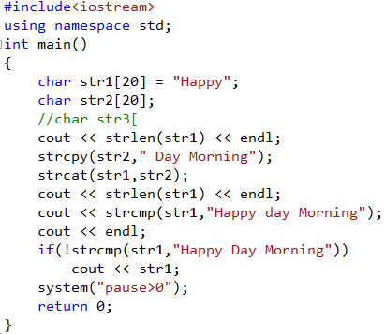

TABLE: SOME PREDEFINED
C-STRING FUNCTIONS IN <cstring>
Source Code:
OUTPUT:

Slide 11

TABLE: SOME PREDEFINED
C-STRING FUNCTIONS IN <cstring>
FUNCTION | DESCRIPTION
strcmp(String_1, String_2) | Returns 0 if String_1 and String_2 are the same. Returns a value < 0 if String_1 is less than String_2. Returns a value > 0 if String_1 is greater than String_2 (that is, returns a nonzero value if String_1 and String_2 are different). The order is lexicographic.
char x[]="good morning ";
char y[25]="Good Morning";
char z[25]="good afternoon";
cout<<x <<" compare "<< y <<"\t"<<strcmp(x,y) <<endl;
cout<<x <<" compare "<< "good morning" <<"\t"<<strcmp(x,"good morning ") <<endl;
cout<<z <<" compare "<< x <<"\t"<<strcmp(z,x) <<endl;
OUTPUT:

Slide 12
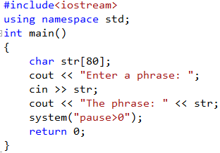

getline
The member function getline can be used to read a line of input and place the string of characters on that line into a C-string variable.
syntax:
cin.getline(String_Var, Max_Characters + 1);
Source Code:
OUTPUT:

Slide 13
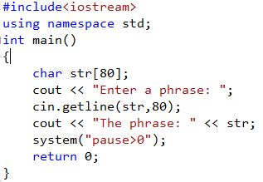

getline
The member function getline can be used to read a line of input and place the string of characters on that line into a C-string variable.
syntax:
cin.getline(String_Var, Max_Characters + 1);
Source Code:
OUTPUT:

Slide 14
CHARACTER MANIPULATION TOOLS
get function allows your program to read in one character of input and store it in a variable of type char
SOURCE CODE:
char a,b,c;
cout<<"Enter any 3 characters ";
cin.get(a);
cin.get(b);
cin.get(c);
cout<<c<<b<<a;
OUTPUT:

Slide 15
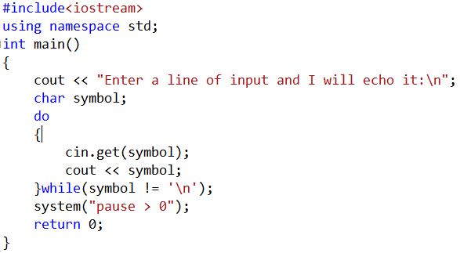
CHARACTER MANIPULATION TOOLS
SOURCE CODE:

Slide 16
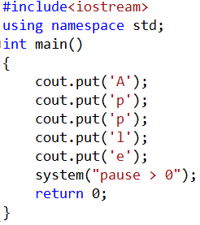

CHARACTER MANIPULATION TOOLS
put This function member is analogous to the member function get except that it is used for output rather than input. The function put allows your program to output one character
SOURCE CODE:
OUTPUT:

Slide 17
CHARACTER-MANIPULATING FUNCTIONS
Table: Some functions in <cctype>
FUNCTION | s
toupper(Char_Exp) | Returns the uppercase version of Char_Exp (as value of type int).
tolower(Char_Exp) | Returns the lowercase version of Char_Exp (as value of type int).
isupper(Char_Exp) | Returns true provided Char_Exp is an uppercase letter; otherwise, returns false.
islower(Char_Exp) | Returns true provided Char_Exp is an lowercase letter; otherwise, returns false.
isalpha(Char_Exp) | Returns true provided Char_Exp is a letter of the alphabet; otherwise returns false.
isdigit(Char_Exp) | Returns true provided Char_Exp is one of the digits ‘0’ through ‘9’; otherwise, returns false.
isalnum(Char_Exp) | Returns true provided Char_Exp is either a letter or a digit; otherwise, returns false.
isspace(Char_Exp) | Returns true provided Char_Exp is a whitespace character, such as the blank or newline character, otherwise, returns false.
ispunct(Char_Exp) | Returns true provided Char_Exp is a printing character other than whitespace, a digit, or a letter; otherwise returns false.
isprint(Char_Exp) | Returns true provided Char_Exp is a printing characters includes blank space; otherwise returns false.
isgraph(Char_Exp) | Returns true provided Char_Exp is a printing characters; otherwise returns false.
isctrl(Char_Exp) | Returns true provided Char_Exp is a control character; otherwise, returns false.

Slide 18
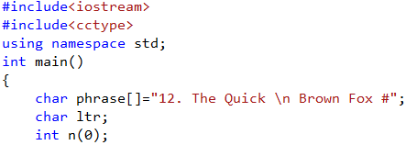

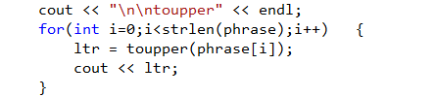

CHARACTER-MANIPULATING FUNCTIONS
toupper(Char_Exp)
Returns the uppercase version of Char_Exp (as value of type int).

Slide 19


CHARACTER-MANIPULATING FUNCTIONS
tolower(Char_Exp)
Returns the lowercase version of Char_Exp (as value of type int).

Slide 20

CHARACTER-MANIPULATING FUNCTIONS
isupper(Char_Exp)
Returns true provided Char_Exp is an uppercase letter; otherwise, returns false.

Slide 21
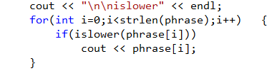
CHARACTER-MANIPULATING FUNCTIONS
islower(Char_Exp)
Returns true provided Char_Exp is an lowercase letter; otherwise, returns false.

Slide 22
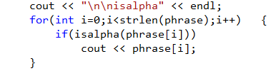
CHARACTER-MANIPULATING FUNCTIONS
isalpha(Char_Exp)
Returns true provided Char_Exp is a letter of the alphabet; otherwise returns false.

Slide 23
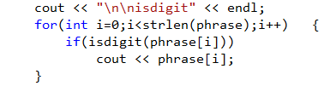
CHARACTER-MANIPULATING FUNCTIONS
isdigit(Char_Exp)
Returns true provided Char_Exp is one of the digits ‘0’ through ‘9’; otherwise, returns false.

Slide 24
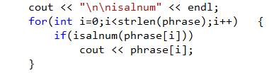
CHARACTER-MANIPULATING FUNCTIONS
isalnum(Char_Exp)
Returns true provided Char_Exp is either a letter or a digit; otherwise, returns false.

Slide 25
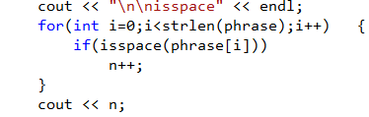
CHARACTER-MANIPULATING FUNCTIONS
isspace(Char_Exp)
Returns true provided Char_Exp is a whitespace character, such as the blank or newline character, otherwise, returns false.

Slide 26

CHARACTER-MANIPULATING FUNCTIONS
isprint(Char_Exp)
Returns true provided Char_Exp is a printing characters includes blank space; otherwise returns false.

Slide 27
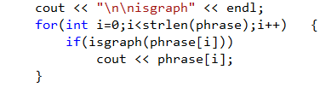
CHARACTER-MANIPULATING FUNCTIONS
isgraph(Char_Exp)
Returns true provided Char_Exp is a printing characters; otherwise returns false.

Slide 28

CHARACTER-MANIPULATING FUNCTIONS
ispunct(Char_Exp)
Returns true provided Char_Exp is a printing character other than whitespace, a digit, or a letter; otherwise returns false.

Slide 29
CHARACTER-MANIPULATING FUNCTIONS
Table: Member Functions of the Standard Class String
Example | Remarks
Constructor
string str; | Default constructor; creates empty string object str.
string str(“string”); | Creates string object with data “string”.
string str(aString); | Creates a string object str that is a copy of aString. aString is an object of the class string.
Element Access
str[i] | Returns read/write reference to character in str at index i.
str.at(i) | Returns read/write reference to character in str at index i.
str.substr(position, length) | Returns the substring of the calling object starting at position and having length characters.

Slide 30
CHARACTER-MANIPULATING FUNCTIONS
Table: Member Functions of the Standard Class String
Example | Remarks
Assignment/Modifiers
str1 = str2 | Allocates space and initializes it to Str2’s data, releases memory allocated for str1, and set str1’s size to that of str2.
str1 += str2 | Character data of str2 is concatenated to the end of str1; the size is set appropriately.
str.empty( ) | Returns true if str is an empty string; returns false otherwise.
str1 + str2 | Returns a string that has str2’s data concatenated to the end of str1’s data. The size is set appropriately.
str.insert(pos, str2) | Insert str2 into str beginning at position pos.
str.remove(pos, length) | Removes substring of size length, starting at position pos.

Slide 31
CHARACTER-MANIPULATING FUNCTIONS
Table: Member Functions of the Standard Class String
Example | Remarks
Comparisons
str1 == str2 str1 != str2 | Compare for equality or inequality; returns a Boolean value.
str1 < str2 str1 > str2 str1 <= str2 str1 >= str2 | Four comparisons. All are lexicographical comparisons
str.find(str1) | Returns index of the first occurrence of str1 in str.
str.find(str1, pos) | Returns index of the first occurrence of string str1 in str; the search starts at position pos.
str.find_first_of(str1, pos) | Returns the index of the first instance in str of any character in str1, starting the search at position pos.
str.find_first_not_of(str1,pos) | Returns the index of the first instance in str of any character not in str1, starting search at position pos.

Slide 32
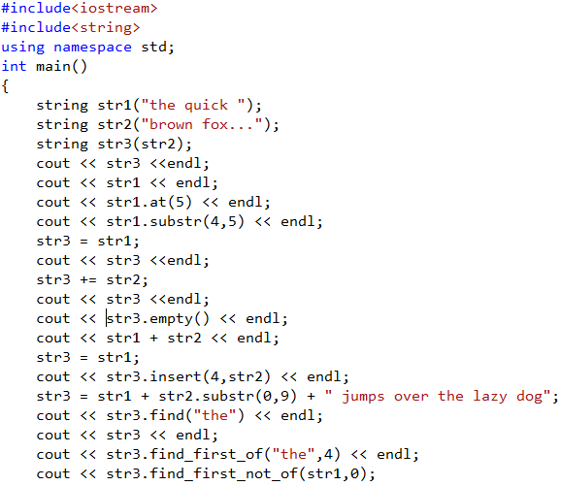

SOURCE CODE

Slide 33
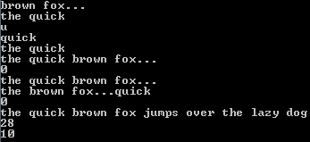
SOURCE CODE

Slide 34
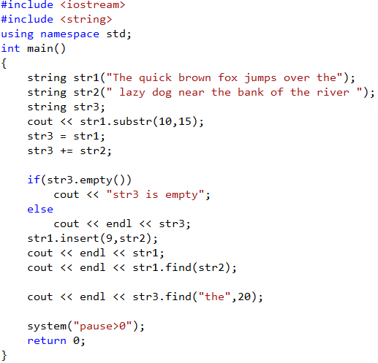
SOURCE CODE

Slide 35

SOURCE CODE

Slide 36
End of Module 3

